Slide 1
Database Administration (DBA)
DBA is a resource that supervises both the database and the use of the DBMS.
DBA is usually a group, but sometimes it refers to the database administrator.

Slide 2
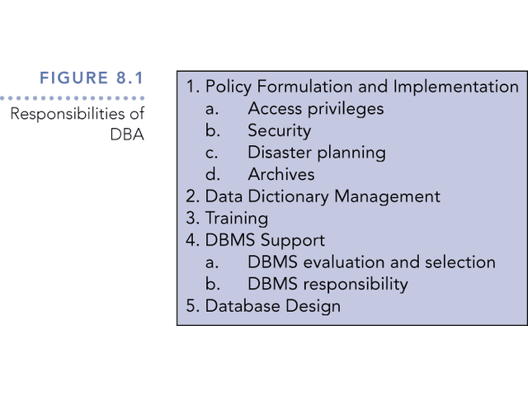
Responsibilities of DBA

Slide 3
Policy Formulation and Implementation
Access Privileges
  Users should access the database only in ways in which they are entitled.
Security
  Access restrictions ensure that the database is secure.
  Passwords, encryption, and views implement security.
  Effective password protection is critical.

Slide 4
Planning for Disaster
Databases can be harmed from hardware and software malfunctions, and outsides forces like floods and power outages.
DBA’s must take active role in formulating disaster recovery plans.

Slide 5
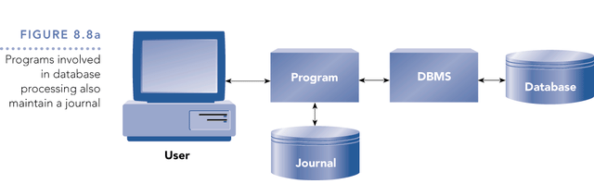
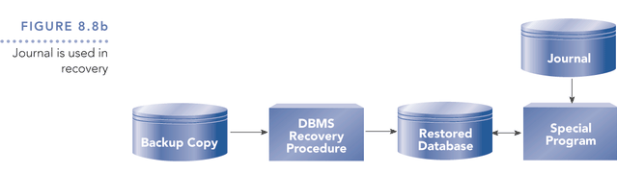
Figure 8.8
Disaster Recovery

Slide 6
Archives
An archive is a place where corporate data is kept.
Information in an archive is removed from the database and stored in the archive for future reference.
Archives are usually kept in a mass-storage device like a disk, tape, CD, or a DVD.
It is important such archives be kept off-site to allow recovery should disaster strike

Slide 7
Data Dictionary Management
Essentially the catalog, but it contains a wider range of information, including information on tables, fields, indexes, and programs.
The DBA manages and updates the data dictionary, which establishes naming conventions for tables, fields, etc., and data integrity rules.

Slide 8
Additional responsibilities of DBA
Training
  DBA gives training on the DBMS and how to access the database
DBMS Support
  The DBA is charged with all aspects of a DBMS, including selection and management
  DBA must evaluate each prospective DBMS using a checklist like that shown in
  Figure 8.10.

Slide 9
Additional Responsibilities of DBA
Database design
  DBA is responsible for tuning the design, i.e., making changes that improve system performance.

